Slide 1
Simple Touch Prediction With Built-In IMUs
Felix Bühler, Benedict Steuerlein
FaPra Machine Learning and Computer Vision for HCI | Pfaffenwaldring 5a | 06.11.18

Slide 2
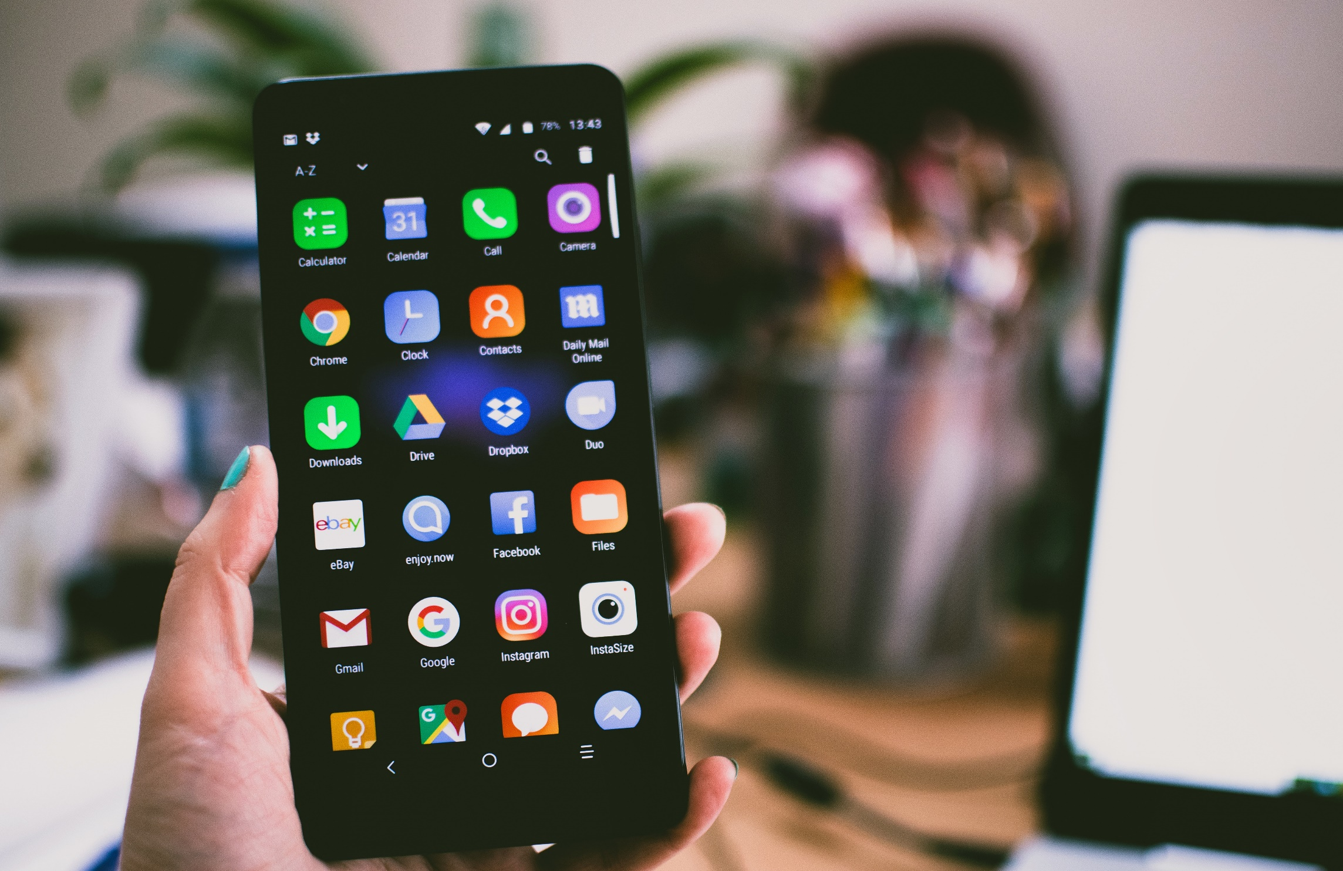
Smartphones sizes are increasing steadily
Whole front screen can not be reached without changing the grip
Predict where users want to touch

Slide 3
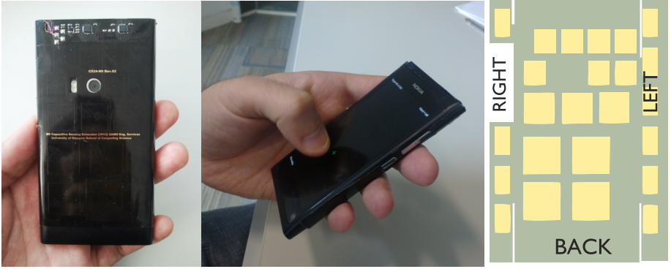
Related Work
24 sensors on Back-of-Device (BoD)
Grip shift on BoD to predict front-of-screen targeting
Mohd Noor, M. F., Ramsay, A., Hughes, S., Rogers, S., Williamson, J., & Murray-Smith, R. 28 frames later: predicting screen touches from back-of-device grip changes. In Proc. of SIGCHI ’14 ACM.
DOI: http://dx.doi.org/10.1145/2556288.2557148
Notes:
They used 24 sensors on the BoD and the laterals to detect grip shifts.
They used Gaussian Process Regression to predict on which side the users wanted to tap,

Slide 4
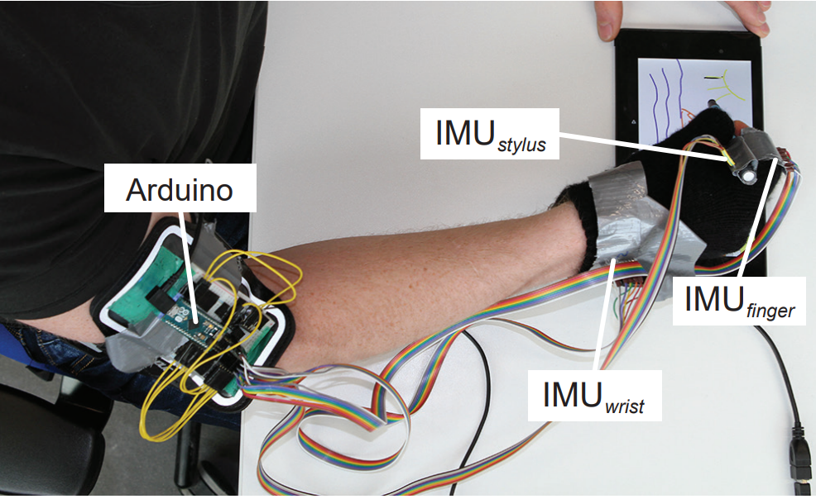
Related Work
Combination of neural network and external IMU
Predict future positions of writing trajectory
Reduce input latency on touch screens
Le, H. V., Schwind, V., Göttlich, P., & Henze, N.. PredicTouch: A System to Reduce Touchscreen Latency using Neural Networks and Inertial Measurement Units. In Proc. of ACM ‘17 International Conference on Interactive Surfaces and Spaces. DOI: http://dx.doi.org/10.1145/3132272.3134138
Notes:
With the help of a neural network and internal measurement units attached to the users arm they were able to predict future positions of the writing trajectory.

Slide 5

Project Plan
Data collection study
Training of a LSTM
Evaluation app
Notes:
Data collection study
15-20 right-handed participants performing x touches in 4 quadrants
3 different sized smartphones
Measurment with IMU‘s
LSTM Network
Time series based data
LongtermShortTermMemory Network
Evaluation Study
App that shows based on IMU measurements the quadrant the user wants to press

Slide 6
Agenda
Nov
Dez
Jan 2019
Feb
Heute
Discussion
11/6/2018
11/13/2018
2018
11/13/2018
Android App
11/27/2018
Data Collection Study
11/28/2018
12/11/2018
8 Tage
12/11/2018
Network Training
1/8/2019
Discussion
15 Tage
1/8/2019
1/15/2019
14 Tage
1/15/2019
Evaluation
1/29/2019
Paper Revision
29 Tage
1/29/2019
2/5/2019
8 Tage
11/27/2018
Writing Paper
2/5/2019
15 Tage
8 Tage
71 Tage

Slide 7
Questions
Data acquisition:
How big should the targets be?
How to treat targets close to the cross?
Study:
How many participants?
How many phones?

